Slide 1
Unscrubbing PeopleofPraise.org
Jim Ecker

Slide 2



September 18th , 2020 Ruth Bader Ginsburg Passes Away
https://dynaimage.cdn.cnn.com/cnn/c_fill,g_auto,w_1200,h_675,ar_16:9/https%3A%2F%2Fcdn.cnn.com%2Fcnnnext%2Fdam%2Fassets%2F200923092952-02-rbg-scotus-0923.jpg
https://www.nytimes.com/2020/09/18/us/ruth-bader-ginsburg-dead.html
https://www.masslive.com/resizer/hpp9rKoEosDnXMbHObU6Jw_R6mk=/450x0/smart/cloudfront-us-east-1.images.arcpublishing.com/advancelocal/W6IGSZEV35GLRLGP7DH2POEDOA.jpg

Slide 3
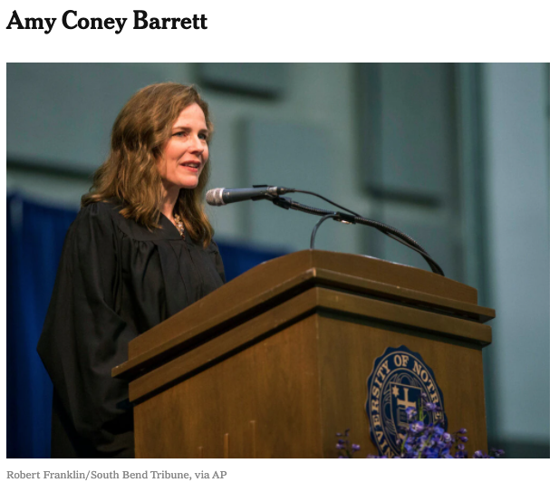

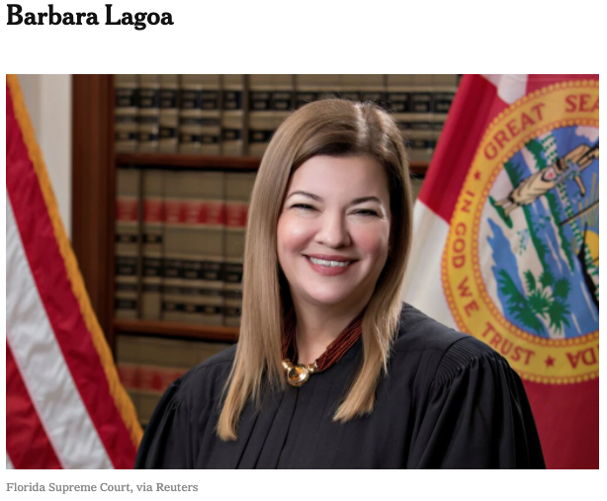
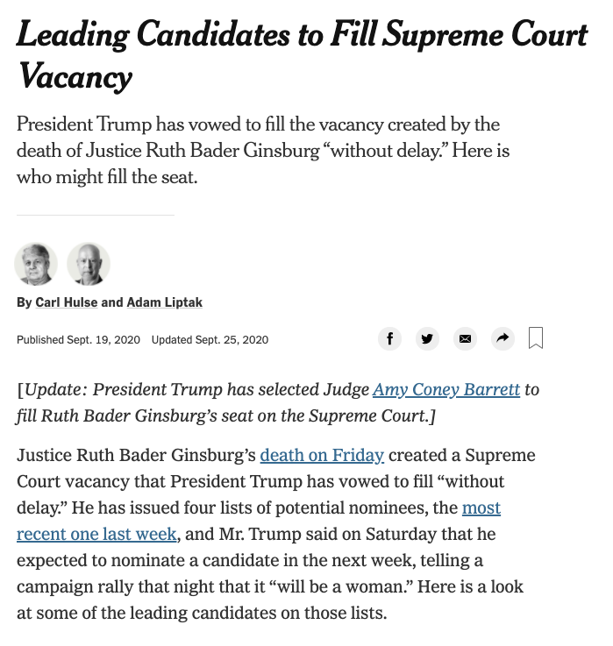


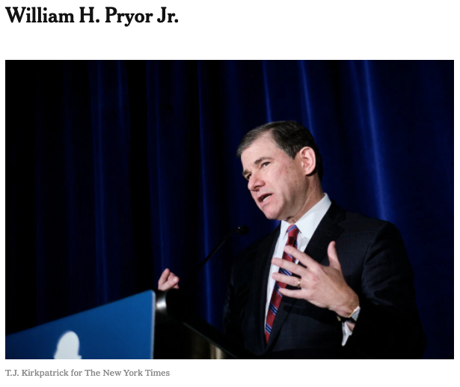
The Trump Administration Scrambles to Fill Vacancy
https://www.nytimes.com/2020/09/19/us/politics/trump-list-of-supreme-court-nominees.html

Slide 4
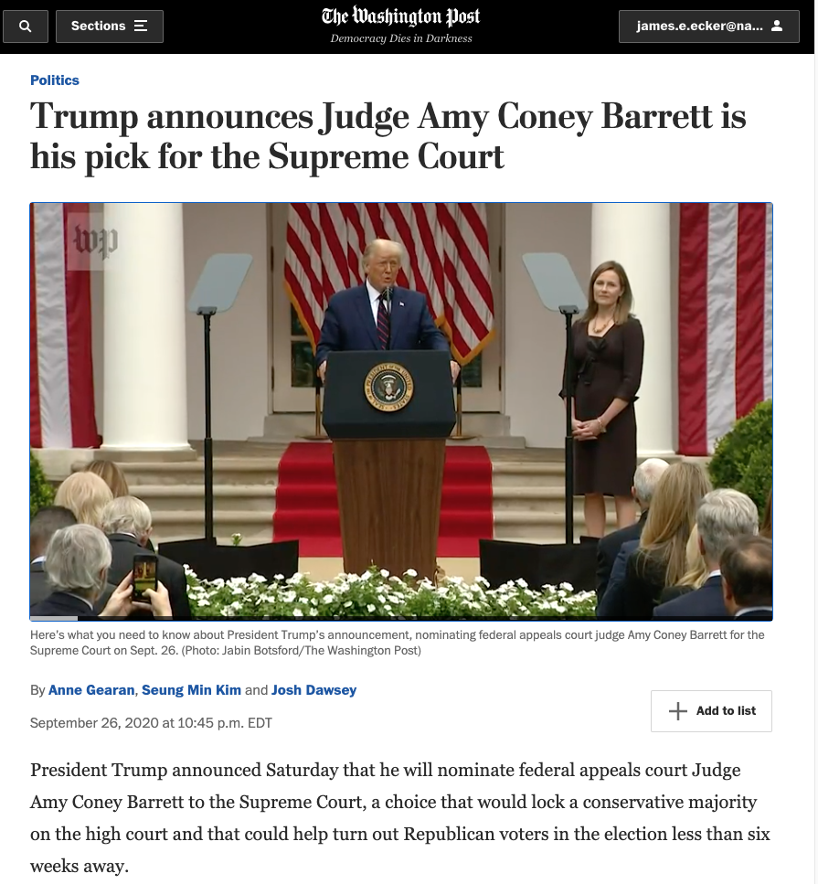

September 26th, 2020 Amy Coney Barrett is Selected for Nomination
https://www.washingtonpost.com/politics/trump-barrett-supreme-court/2020/09/26/4a417d60-000e-11eb-b555-4d71a9254f4b_story.html
https://en.wikipedia.org/wiki/Amy_Coney_Barrett#/media/File:Amy_Coney_Barrett.jpg

Slide 5


“I’m Sure it will be Extremely Non-controversial”
https://media.npr.org/assets/img/2020/10/12/201012_coneybarrett_confirmation_12_custom-a09d95b4238e8cddbeb8b3223835affa99e5f5d5-s800-c85.jpg
https://media.npr.org/assets/img/2020/10/12/201012_coneybarrett_confirmation_04_custom-abe90e8f6d771752db0b68d8714e5dbf5e397807-s800-c85.jpg

Slide 6


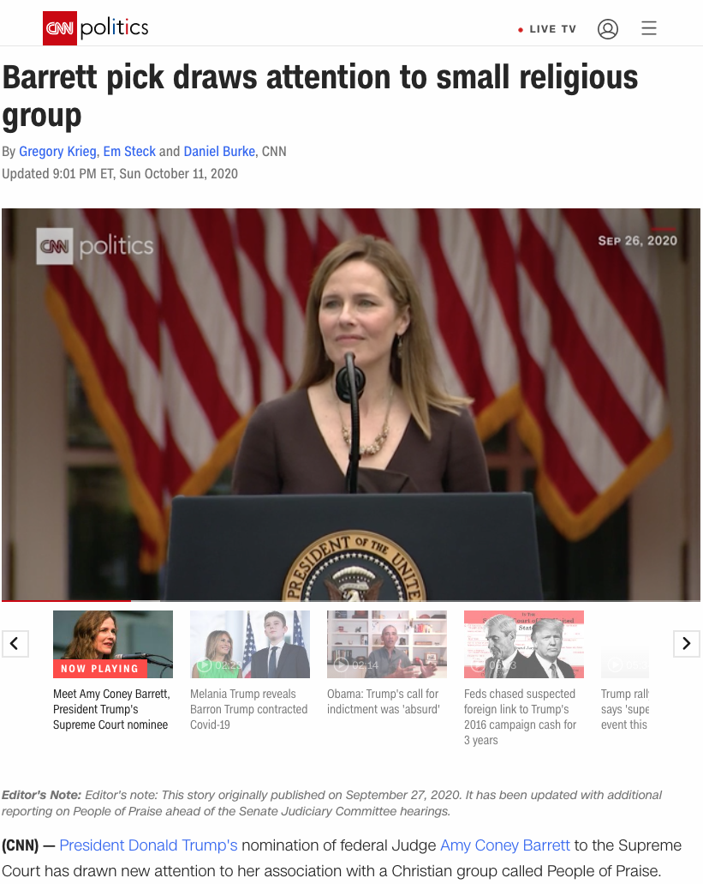
Spotlight on Barrett’s Religious Background
https://www.wsj.com/articles/the-truth-about-people-of-praise-11600990129
https://www.rollingstone.com/culture/culture-news/amy-coney-barrett-people-of-praise-1067587/
https://www.cnn.com/2020/09/27/politics/amy-coney-barrett-people-of-praise/index.html

Slide 7
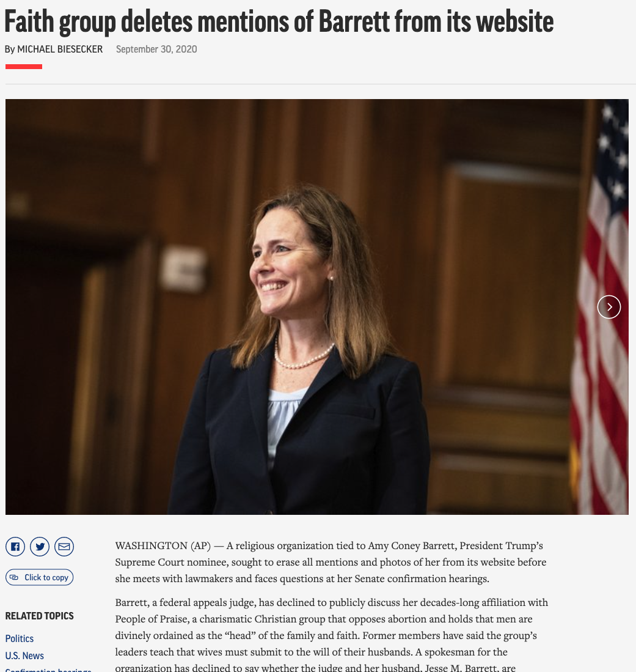
The Associated Press Discovers Evidence of Data Scrubbing
“A religious organization tied to Amy Coney Barrett, President Trump’s Supreme Court nominee, sought to erase all mentions and photos of her from its website before she meets with lawmakers and faces questions at her Senate confirmation hearings.”
“People of Praise erased numerous records from its website during the summer of 2017 that referred to Barrett and included photos of her and her family.”
“At the time, Barrett was on Trump’s short list for the high court seat that eventually went to Justice Brett Kavanaugh.
https://apnews.com/article/us-supreme-court-amy-coney-barrett-confirmation-hearings-archive-courts-78dc1bd9d1470c7ea1357f495a4da26b

Slide 8
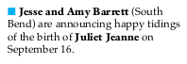
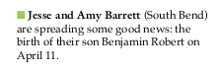
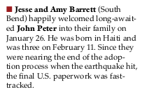
What was scrubbed?
Back issues of “Vine & Branches”
Birth and adoption announcements
https://web.archive.org/web/20151018030811/https://peopleofpraise.org/media/thevine/2011-winter-vine-and-branches.pdf
https://web.archive.org/web/20151018031423/https://peopleofpraise.org/media/thevine/2012-summer-vine-and-branches.pdf
https://web.archive.org/web/20151018015716/https://peopleofpraise.org/media/thevine/2010-03-vine-and-branches.pdf

Slide 9
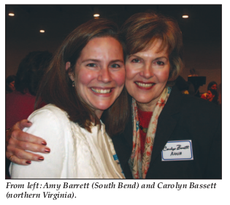
What was scrubbed?
Back issues of “Vine & Branches”
Birth and adoption announcements
2006 issue of the magazine that included a photo of Amy Barrett attending the group’s Leaders’ Conference for Women
https://web.archive.org/web/20071028065558/https://peopleofpraise.org/thevine/issues/2006-05-vine-and-branches.pdf

Slide 10

What was scrubbed?
Back issues of “Vine & Branches”
Birth and adoption announcements
2006 issue of the magazine that included a photo of Amy Barrett attending the group’s Leaders’ Conference for Women
2008 feature article described how three of Amy Barrett’s young daughters in Indiana were using then-newly developed video conferencing technology
https://web.archive.org/web/20121202204939/https://peopleofpraise.org/thevine/issues/2008-07-vine-and-branches.pdf

Slide 11
What was scrubbed?
Back issues of “Vine & Branches”
2006 magazine story about Barrett’s parents that referred to Linda Coney as a “handmaid”
February and June 2006 issues are missing from archives (verified with Memgator)
curl -s http://memgator.cs.odu.edu/timemap/link/http://peopleofpraise.org/thevine/issues/2006-02-vine-and-branches.pdf
> 404 page not found
curl -s http://memgator.cs.odu.edu/timemap/link/http://peopleofpraise.org/thevine/issues/2006-06-vine-and-branches.pdf
> 404 page not found

Slide 12
What was scrubbed?
curl -s "http://web.archive.org/cdx/search/cdx?url=peopleofpraise.org/thevine&matchType=prefix" | sort -k 2 | awk '{print "https://web.archive.org/web/" $2 "/" $3};' | grep pdf | grep 2006
https://web.archive.org/web/20071026150642/http://www.peopleofpraise.org/thevine/issues/2006-04-vine-and-branches.pdf
https://web.archive.org/web/20071028065412/http://www.peopleofpraise.org/thevine/issues/2006-07-vine-and-branches.pdf
https://web.archive.org/web/20071028065513/http://www.peopleofpraise.org/thevine/issues/2006-12-vine-and-branches.pdf
https://web.archive.org/web/20071028065558/http://www.peopleofpraise.org/thevine/issues/2006-05-vine-and-branches.pdf
https://web.archive.org/web/20071028065725/http://www.peopleofpraise.org/thevine/issues/2006-03-vine-and-branches.pdf
https://web.archive.org/web/20071028070038/http://www.peopleofpraise.org/thevine/issues/2006-08-vine-and-branches.pdf
https://web.archive.org/web/20071028070156/http://www.peopleofpraise.org/thevine/issues/2006-11-vine-and-branches.pdf
https://web.archive.org/web/20071028070245/http://www.peopleofpraise.org/thevine/issues/2006-09-10-vine-and-branches.pdf
https://web.archive.org/web/20080509070214/http://www.peopleofpraise.org/thevine/issues/2006-05-vine-and-branches.pdf
https://web.archive.org/web/20080509070251/http://www.peopleofpraise.org/thevine/issues/2006-09-10-vine-and-branches.pdf
https://web.archive.org/web/20080509072617/http://www.peopleofpraise.org/thevine/issues/2006-11-vine-and-branches.pdf
https://web.archive.org/web/20080509073213/http://www.peopleofpraise.org/thevine/issues/2006-08-vine-and-branches.pdf
https://web.archive.org/web/20080509092601/http://www.peopleofpraise.org/thevine/issues/2006-07-vine-and-branches.pdf
https://web.archive.org/web/20080511171446/http://www.peopleofpraise.org/thevine/issues/2006-04-vine-and-branches.pdf
https://web.archive.org/web/20080511210426/http://www.peopleofpraise.org/thevine/issues/2006-03-vine-and-branches.pdf
https://web.archive.org/web/20080515170500/http://www.peopleofpraise.org/thevine/issues/2006-12-vine-and-branches.pdf
https://web.archive.org/web/20110220150239/http://www.peopleofpraise.org:80/thevine/issues/2006-03-vine-and-branches.pdf
https://web.archive.org/web/20131209042936/http://www.peopleofpraise.org/thevine/issues/2006-07-vine-and-branches.pdf
Back issues of “Vine & Branches”
2006 magazine story about Barrett’s parents that referred to Linda Coney as a “handmaid”
curl -s "http://web.archive.org/cdx/search/cdx?url=peopleofpraise.org/thevine&matchType=prefix" | sort -k 2 | awk '{print "https://web.archive.org/web/" $2 "/" $3};' | grep pdf | grep 2006

Slide 13
What was scrubbed?
Back issues of “Vine & Branches”
2006 magazine story about Barrett’s parents that referred to Linda Coney as a “handmaid”
curl -s "http://web.archive.org/cdx/search/cdx?url=peopleofpraise.org/media&matchType=prefix" | sort -k 2 | awk '{print "https://web.archive.org/web/" $2 "/" $3};' | grep pdf | grep 2006
https://web.archive.org/web/20151018015735/http://peopleofpraise.org/media/thevine/2006-04-vine-and-branches.pdf
https://web.archive.org/web/20151018020922/http://peopleofpraise.org/media/thevine/2006-12-vine-and-branches.pdf
https://web.archive.org/web/20151018072806/http://peopleofpraise.org/media/thevine/2006-03-vine-and-branches.pdf
https://web.archive.org/web/20151018074252/http://peopleofpraise.org/media/thevine/2006-08-vine-and-branches.pdf
https://web.archive.org/web/20151018074304/http://peopleofpraise.org/media/thevine/2006-09-10-vine-and-branches.pdf
https://web.archive.org/web/20151018074358/http://peopleofpraise.org/media/thevine/2006-05-vine-and-branches.pdf
https://web.archive.org/web/20151018082033/http://peopleofpraise.org/media/thevine/2006-07-vine-and-branches.pdf
https://web.archive.org/web/20151018082040/http://peopleofpraise.org/media/thevine/2006-11-vine-and-branches.pdf
https://web.archive.org/web/20170304180427/http://peopleofpraise.org/media/thevine/2006-04-vine-and-branches.pdf
https://web.archive.org/web/20170304182428/http://peopleofpraise.org/media/thevine/2006-12-vine-and-branches.pdf
https://web.archive.org/web/20170304213116/http://peopleofpraise.org/media/thevine/2006-03-vine-and-branches.pdf
https://web.archive.org/web/20170304213753/http://peopleofpraise.org/media/thevine/2006-05-vine-and-branches.pdf
https://web.archive.org/web/20170305001527/http://peopleofpraise.org/media/thevine/2006-08-vine-and-branches.pdf
https://web.archive.org/web/20170305001544/http://peopleofpraise.org/media/thevine/2006-09-10-vine-and-branches.pdf
https://web.archive.org/web/20170305001622/http://peopleofpraise.org/media/thevine/2006-11-vine-and-branches.pdf
https://web.archive.org/web/20170305013217/http://peopleofpraise.org/media/thevine/2006-07-vine-and-branches.pdf
https://web.archive.org/web/20190107070251/https://peopleofpraise.org/media/thevine/2006-07-vine-and-branches.pdf
https://web.archive.org/web/20190107070756/https://peopleofpraise.org/media/thevine/2006-12-vine-and-branches.pdf
https://web.archive.org/web/20190107071822/https://peopleofpraise.org/media/thevine/2006-04-vine-and-branches.pdf
https://web.archive.org/web/20190107075212/https://peopleofpraise.org/media/thevine/2006-09-10-vine-and-branches.pdf
https://web.archive.org/web/20190107081820/https://peopleofpraise.org/media/thevine/2006-03-vine-and-branches.pdf
https://web.archive.org/web/20190107082349/https://peopleofpraise.org/media/thevine/2006-08-vine-and-branches.pdf
https://web.archive.org/web/20200920040308/https://peopleofpraise.org/media/thevine/2006-12-vine-and-branches.pdf
https://web.archive.org/web/20200920040310/https://peopleofpraise.org/media/thevine/2006-11-vine-and-branches.pdf
https://web.archive.org/web/20200920040312/https://peopleofpraise.org/media/thevine/2006-07-vine-and-branches.pdf
https://web.archive.org/web/20200920040328/https://peopleofpraise.org/media/thevine/2006-08-vine-and-branches.pdf
https://web.archive.org/web/20200920040354/https://peopleofpraise.org/media/thevine/2006-04-vine-and-branches.pdf
https://web.archive.org/web/20200920040400/https://peopleofpraise.org/media/thevine/2006-03-vine-and-branches.pdf
https://web.archive.org/web/20200920040456/https://peopleofpraise.org/media/thevine/2006-09-10-vine-and-branches.pdf
curl -s "http://web.archive.org/cdx/search/cdx?url=peopleofpraise.org/media&matchType=prefix" | sort -k 2 | awk '{print "https://web.archive.org/web/" $2 "/" $3};' | grep pdf | grep 2006

Slide 14
What was scrubbed?
curl -s "http://web.archive.org/cdx/search/cdx?url=peopleofpraise.org/media&matchType=prefix" | sort -k 2 | awk '{print "https://web.archive.org/web/" $2 "/" $3};' | grep pdf | grep 06
https://web.archive.org/web/20151018015735/http://peopleofpraise.org/media/thevine/2006-04-vine-and-branches.pdf
https://web.archive.org/web/20151018020506/http://peopleofpraise.org/media/thevine/2012-spring-vine-and-branches.pdf
https://web.archive.org/web/20151018020633/http://peopleofpraise.org/media/thevine/2010-summer-vine-and-branches.pdf
https://web.archive.org/web/20151018020922/http://peopleofpraise.org/media/thevine/2006-12-vine-and-branches.pdf
https://web.archive.org/web/20151018072806/http://peopleofpraise.org/media/thevine/2006-03-vine-and-branches.pdf
https://web.archive.org/web/20151018073008/http://peopleofpraise.org/media/thevine/2008-06-vine-and-branches.pdf
https://web.archive.org/web/20151018074202/http://peopleofpraise.org/media/main/vb/add/January06VB.pdf
https://web.archive.org/web/20151018074252/http://peopleofpraise.org/media/thevine/2006-08-vine-and-branches.pdf
https://web.archive.org/web/20151018074304/http://peopleofpraise.org/media/thevine/2006-09-10-vine-and-branches.pdf
https://web.archive.org/web/20151018074358/http://peopleofpraise.org/media/thevine/2006-05-vine-and-branches.pdf
https://web.archive.org/web/20151018081950/http://peopleofpraise.org/media/thevine/2009-05-06-vine-and-branches.pdf
https://web.archive.org/web/20151018082033/http://peopleofpraise.org/media/thevine/2006-07-vine-and-branches.pdf
https://web.archive.org/web/20151018082040/http://peopleofpraise.org/media/thevine/2006-11-vine-and-branches.pdf
https://web.archive.org/web/20160412062302/http://peopleofpraise.org:80/media/page/page/37/change/pledge%20card%20mission%20fund%20for%20web.pdf
https://web.archive.org/web/20170304180232/http://peopleofpraise.org/media/main/vb/add/January06VB.pdf
https://web.archive.org/web/20170304180427/http://peopleofpraise.org/media/thevine/2006-04-vine-and-branches.pdf
https://web.archive.org/web/20170304181606/http://peopleofpraise.org/media/thevine/2009-03-04-vine-and-branches.pdf
https://web.archive.org/web/20170304182428/http://peopleofpraise.org/media/thevine/2006-12-vine-and-branches.pdf
https://web.archive.org/web/20170304194641/http://peopleofpraise.org/media/thevine/2009-05-06-vine-and-branches.pdf
https://web.archive.org/web/20170304213116/http://peopleofpraise.org/media/thevine/2006-03-vine-and-branches.pdf
https://web.archive.org/web/20170304213753/http://peopleofpraise.org/media/thevine/2006-05-vine-and-branches.pdf
https://web.archive.org/web/20170304221853/http://peopleofpraise.org/media/thevine/2008-06-vine-and-branches.pdf
https://web.archive.org/web/20170305001527/http://peopleofpraise.org/media/thevine/2006-08-vine-and-branches.pdf
https://web.archive.org/web/20170305001544/http://peopleofpraise.org/media/thevine/2006-09-10-vine-and-branches.pdf
https://web.archive.org/web/20170305001622/http://peopleofpraise.org/media/thevine/2006-11-vine-and-branches.pdf
https://web.archive.org/web/20170305013217/http://peopleofpraise.org/media/thevine/2006-07-vine-and-branches.pdf
https://web.archive.org/web/20170305064111/http://peopleofpraise.org/media/thevine/2008-10-11-vine-and-branches.pdf
https://web.archive.org/web/20170305064117/http://peopleofpraise.org/media/main/vb/add/Dec2005VB.pdf
https://web.archive.org/web/20190107070137/https://peopleofpraise.org/media/main/vb/add/January06VB.pdf
https://web.archive.org/web/20190107070251/https://peopleofpraise.org/media/thevine/2006-07-vine-and-branches.pdf
https://web.archive.org/web/20190107070756/https://peopleofpraise.org/media/thevine/2006-12-vine-and-branches.pdf
https://web.archive.org/web/20190107071822/https://peopleofpraise.org/media/thevine/2006-04-vine-and-branches.pdf
https://web.archive.org/web/20190107075212/https://peopleofpraise.org/media/thevine/2006-09-10-vine-and-branches.pdf
https://web.archive.org/web/20190107081820/https://peopleofpraise.org/media/thevine/2006-03-vine-and-branches.pdf
https://web.archive.org/web/20190107082339/https://peopleofpraise.org/media/thevine/2008-06-vine-and-branches.pdf
https://web.archive.org/web/20190107082349/https://peopleofpraise.org/media/thevine/2006-08-vine-and-branches.pdf
https://web.archive.org/web/20200920040308/https://peopleofpraise.org/media/thevine/2006-12-vine-and-branches.pdf
https://web.archive.org/web/20200920040310/https://peopleofpraise.org/media/thevine/2006-11-vine-and-branches.pdf
https://web.archive.org/web/20200920040312/https://peopleofpraise.org/media/thevine/2006-07-vine-and-branches.pdf
https://web.archive.org/web/20200920040328/https://peopleofpraise.org/media/thevine/2006-08-vine-and-branches.pdf
https://web.archive.org/web/20200920040346/https://peopleofpraise.org/media/main/vb/add/January06VB.pdf
https://web.archive.org/web/20200920040354/https://peopleofpraise.org/media/thevine/2006-04-vine-and-branches.pdf
https://web.archive.org/web/20200920040400/https://peopleofpraise.org/media/thevine/2006-03-vine-and-branches.pdf
https://web.archive.org/web/20200920040406/https://peopleofpraise.org/media/pdf/winter%202017%20v%26b%20%285%29%202.pdf
https://web.archive.org/web/20200920040430/https://peopleofpraise.org/media/thevine/2008-06-vine-and-branches.pdf
https://web.archive.org/web/20200920040456/https://peopleofpraise.org/media/thevine/2006-09-10-vine-and-branches.pdf
https://web.archive.org/web/20200921183719/https://peopleofpraise.org/media/main/vb/add/January06VB.pdf
Back issues of “Vine & Branches”
2006 magazine story about Barrett’s parents that referred to Linda Coney as a “handmaid”
curl -s "http://web.archive.org/cdx/search/cdx?url=peopleofpraise.org/media&matchType=prefix" | sort -k 2 | awk '{print "https://web.archive.org/web/" $2 "/" $3};' | grep pdf | grep 06

Slide 15
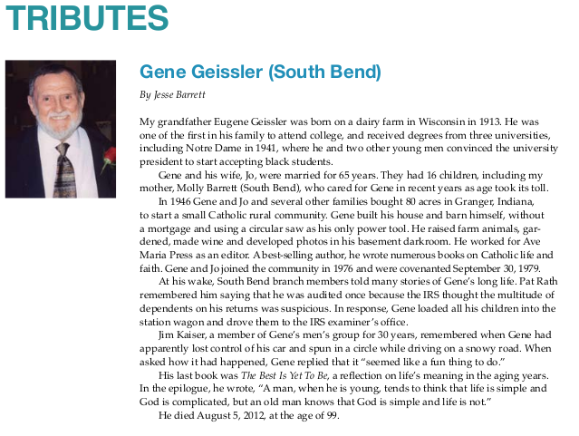
What was scrubbed?
Back issues of “Vine & Branches”
2006 magazine story about Barrett’s parents that referred to Linda Coney as a “handmaid”
2012 tribute written by Jesse Barrett about his recently deceased grandfather, Eugene Geissler
https://web.archive.org/web/20170305001600/http://peopleofpraise.org/media/thevine/2012-fall-vine-and-branches.pdf

Slide 16







March 2017 - The First Purge
Direct references to Amy Barrett: 1
References to Barrett family: 2
References to extended family: 6
References to unknown relation: 6
PDFs referencing Amy Barrett: 1
PDFs referencing Barrett Family: 3
Total PDFs: 7
One reference per PDF
https://web.archive.org/web/20170104222314/https://peopleofpraise.org/media/thevine/2006-05-vine-and-branches.pdf
https://web.archive.org/web/20170104222314/https://peopleofpraise.org/media/thevine/2007-07-vine-and-branches.pdf
https://web.archive.org/web/20170104222314/https://peopleofpraise.org/media/thevine/2007-12-vine-and-branches.pdf
https://web.archive.org/web/20170104222314/https://peopleofpraise.org/media/thevine/2008-05-vine-and-branches.pdf
https://web.archive.org/web/20170104222314/https://peopleofpraise.org/media/thevine/2009-05-06-vine-and-branches.pdf
https://web.archive.org/web/20170104222314/https://peopleofpraise.org/media/thevine/2012-fall-vine-and-branches.pdf
https://web.archive.org/web/20170104222314/https://peopleofpraise.org/media/main/vb/add/Dec2005VB.pdf

Slide 17




June 2017 - The Second Purge
Direct references to Amy Barrett: 4
References to Barrett family: 9
References to extended family: 3
References to unknown relation: 5
PDFs referencing Amy Barrett: 4
PDFs referencing Barrett Family: 5
Total PDFs: 5
One reference per PDF
https://web.archive.org/web/20170104222314/https://peopleofpraise.org/media/thevine/2008-07-vine-and-branches.pdf
https://web.archive.org/web/20170104222314/https://peopleofpraise.org/media/thevine/2008-12-vine-and-branches.pdf
https://web.archive.org/web/20170104222314/https://peopleofpraise.org/media/thevine/2010-03-vine-and-branches.pdf
https://web.archive.org/web/20170104222314/https://peopleofpraise.org/media/thevine/2011-winter-vine-and-branches.pdf
https://web.archive.org/web/20170104222314/https://peopleofpraise.org/media/thevine/2012-summer-vine-and-branches.pdf

Slide 18
References in Unpurged Issues of Vine and Branches
Direct references to Amy Barrett: 0
References to Barrett family: 2
References to extended family: 12
References to unknown relation: 15
PDFs referencing Amy Barrett: 0
PDFs referencing Barrett Family: 2
Total PDFs: 29
One reference per PDF
https://web.archive.org/web/20200922092924/https://peopleofpraise.org/media/thevine/2006-04-vine-and-branches.pdf
https://web.archive.org/web/20200922092924/https://peopleofpraise.org/media/thevine/2006-07-vine-and-branches.pdf
https://web.archive.org/web/20200922092924/https://peopleofpraise.org/media/thevine/2006-09-10-vine-and-branches.pdf
https://web.archive.org/web/20200922092924/https://peopleofpraise.org/media/thevine/2006-11-vine-and-branches.pdf
https://web.archive.org/web/20200922092924/https://peopleofpraise.org/media/thevine/2006-12-vine-and-branches.pdf
https://web.archive.org/web/20200922092924/https://peopleofpraise.org/media/thevine/2007-02-vine-and-branches.pdf
https://web.archive.org/web/20200922092924/https://peopleofpraise.org/media/thevine/2007-03-04-vine-and-branches.pdf
https://web.archive.org/web/20200922092924/https://peopleofpraise.org/media/thevine/2007-05-vine-and-branches.pdf
https://web.archive.org/web/20200922092924/https://peopleofpraise.org/media/thevine/2007-08-vine-and-branches.pdf
https://web.archive.org/web/20200922092924/https://peopleofpraise.org/media/thevine/2007-11-vine-and-branches.pdf
https://web.archive.org/web/20200922092924/https://peopleofpraise.org/media/thevine/2008-01-vine-and-branches.pdf
https://web.archive.org/web/20200922092924/https://peopleofpraise.org/media/thevine/2008-04-vine-and-branches.pdf
https://web.archive.org/web/20200922092924/https://peopleofpraise.org/media/thevine/2008-10-11-vine-and-branches.pdf
https://web.archive.org/web/20200922092924/https://peopleofpraise.org/media/thevine/2009-02-vine-and-branches.pdf
https://web.archive.org/web/20200922092924/https://peopleofpraise.org/media/thevine/2009-10-11-vine-and-branches.pdf
https://web.archive.org/web/20200922092924/https://peopleofpraise.org/media/thevine/2010-summer-vine-and-branches.pdf
https://web.archive.org/web/20200922092924/https://peopleofpraise.org/media/thevine/2011-fall-vine-and-branches.pdf
https://web.archive.org/web/20200922092924/https://peopleofpraise.org/media/thevine/2011-spring-summer-vine-and-branches.pdf
https://web.archive.org/web/20200922092924/https://peopleofpraise.org/media/thevine/2013-fall-vine-and-branches.pdf
https://web.archive.org/web/20200922092924/https://peopleofpraise.org/media/thevine/2013-summer-vine-and-branches.pdf
https://web.archive.org/web/20200922092924/https://peopleofpraise.org/media/thevine/2013-winter-vine-and-branches.pdf
https://web.archive.org/web/20200922092924/https://peopleofpraise.org/media/thevine/2014-winter-vine-and-branches.pdf
https://web.archive.org/web/20200922092924/https://peopleofpraise.org/media/main/vb/add/January06VB.pdf
https://web.archive.org/web/20200922092924/https://peopleofpraise.org/media/main/vb/15/Sept.V%26B%207%2023%2014.pdf
https://web.archive.org/web/20200922092924/https://peopleofpraise.org/media/main/vb/50/V%26B%20Fall%202015%20web%202.pdf
https://web.archive.org/web/20200922092924/https://peopleofpraise.org/media/pdf/V%26B%20late%20fall%202016%20web%204.pdf
https://web.archive.org/web/20200922092924/https://peopleofpraise.org/media/pdf/V%26B%20Summer%202017%20web.pdf
https://web.archive.org/web/20200922092924/https://peopleofpraise.org/media/main/vb/45/V%26B%20Winter%202015%20w%20palmer.pdf
https://web.archive.org/web/20200922092924/https://peopleofpraise.org/media/pdf/winter%20v%26b.pdf

Slide 19
Other Deletions
Renames
https://web.archive.org/web/20080225093422/https://peopleofpraise.org/thevine/
2007-09-vine-and-branches.pdf > 2007-09-10-vine-and-branches.pdf
https://web.archive.org/web/20150423190903/https://peopleofpraise.org/thevine/
2007-09-10-vine-and-branches.pdf > Sept.V&B 7 23 14.pdf
2014-fall-vine-and-branches.pdf. > V&B Fall 2014 for web 3.pdf
https://web.archive.org/web/20150816011059/https://peopleofpraise.org/thevine/
V&B Winter 2015.pdf > V&B Winter 2015 w palmer.pdf
References
2009-05-06-vine-and-branches.pdf went missing between https://web.archive.org/web/20120912222546/http://www.peopleofpraise.org/thevine/ and https://web.archive.org/web/20150423190903/https:/peopleofpraise.org/thevine/
Was probably fixed during the renames reflected by the same memento

Slide 20



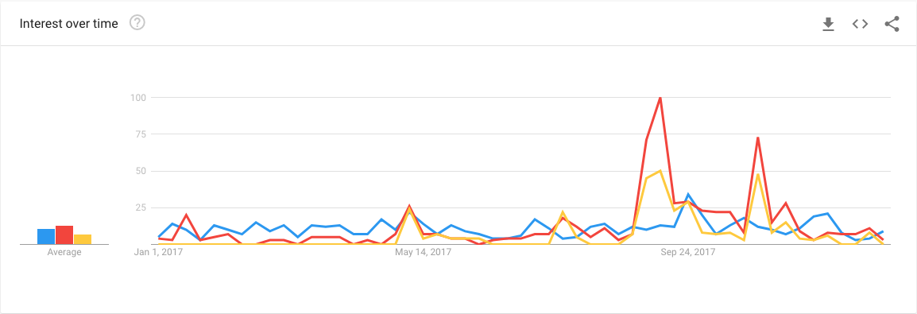
2017 in a Nutshell
Atlantic Article
Gorsuch Confirmation Hearings Start
Planned Parenthood
Confirmation Hearings Start
Neil Gorsuch Nominated
Gorsuch Confirmed
First V&B Purge
Amy Barrett Nominated to 7th Circuit
Second V&B Purge
https://trends.google.com/trends/explore?date=2017-01-01%202017-12-31&geo=US&q=people%20of%20praise,Amy%20Barrett,Amy%20Coney%20Barrett

Slide 21

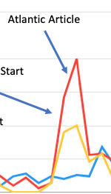
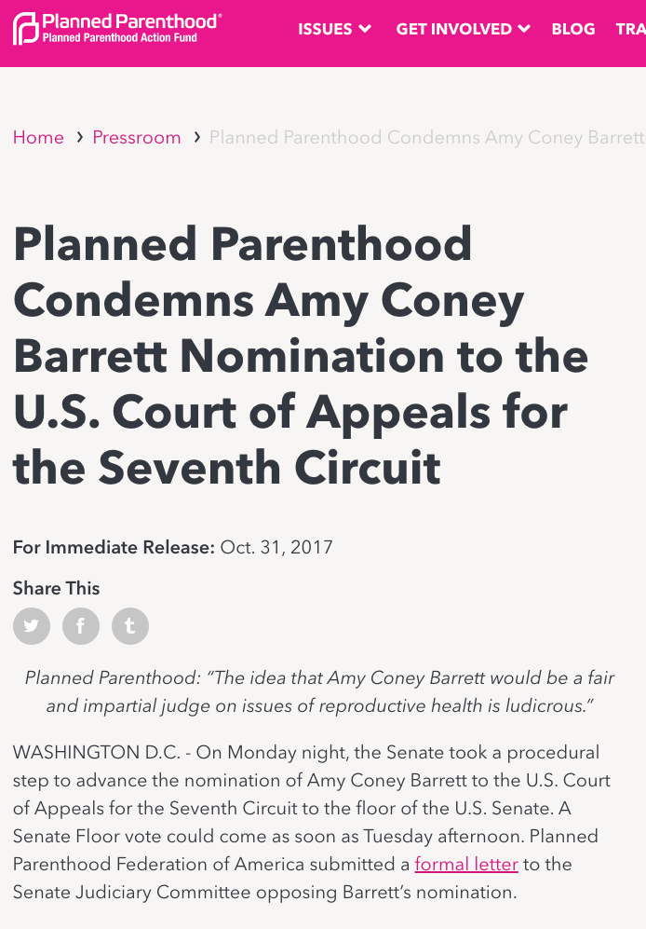
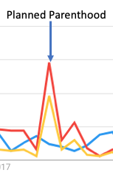
Spikes!
https://www.theatlantic.com/politics/archive/2017/09/catholics-senate-amy-barrett/539124/
https://www.plannedparenthoodaction.org/pressroom/planned-parenthood-condemns-amy-coney-barrett-nomination-to-the-u-s-court-of-appeals-for-the-seventh-circuit

Slide 22
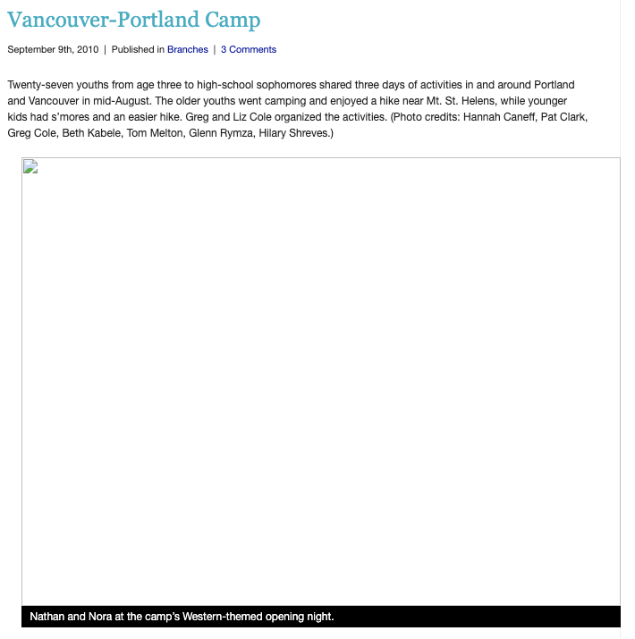
Blog Posts
3 news blog posts in archives but missing from live web
news/?p=882
https://web.archive.org/web/20110104040008/http://peopleofpraise.org/news/?p=882

Slide 23
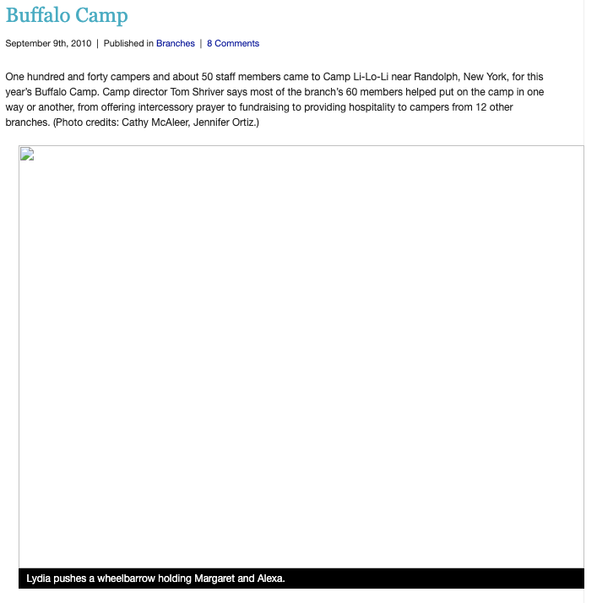
Another Camp Post
3 news blog posts in archives but missing from live web
news/?p=882
news/?p=1003
https://web.archive.org/web/20110104033453/http://peopleofpraise.org/news/?p=1003

Slide 24
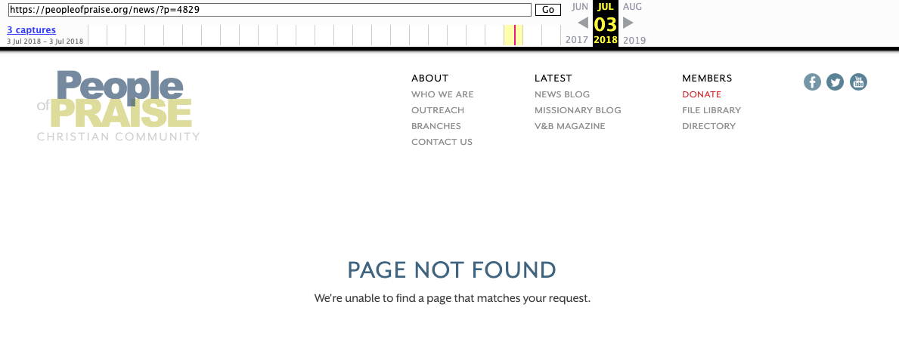
A Mysterious Post Archived as ‘Page Not Found’
3 news blog posts in archives but missing from live web
news/?p=882
news/?p=1003
news/?p=4829
https://web.archive.org/web/20180703225527/https://peopleofpraise.org/news/?p=4829

Slide 25
Verifying in Dataset
dataset/archived_news_posts.csv
20180703215205, https://peopleofpraise.org/news/?p=6632 , 6632, June 27 2018 10:09 a.m
20180703215431, http://peopleofpraise.org:80/news/?p=4829, 4829,,,
20180703215432, https://peopleofpraise.org/news/?p=4829, 4829,,,
20180703215438, http://peopleofpraise.org:80/news/?p=3349, 3349, Dec. 9 2013 5:06 p.m
20180703215438, https://peopleofpraise.org/news/?p=3349, 3349, Dec. 9 2013 5:06 p.m.
20180703225527, https://peopleofpraise.org/news/?p=4829, 4829,,,

Slide 26
Verifying in Dataset
dataset/archived_news_posts.csv
20180703215205, https://peopleofpraise.org/news/?p=6632 , 6632, June 27 2018 10:09 a.m
20180703215431, http://peopleofpraise.org:80/news/?p=4829, 4829,,,
20180703215432, https://peopleofpraise.org/news/?p=4829, 4829,,,
20180703215438, http://peopleofpraise.org:80/news/?p=3349, 3349, Dec. 9 2013 5:06 p.m
20180703215438, https://peopleofpraise.org/news/?p=3349, 3349, Dec. 9 2013 5:06 p.m.
20180703225527, https://peopleofpraise.org/news/?p=4829, 4829,,,
20160402002454, http://peopleofpraise.org/news/?p=4821, 4821, Sept. 1 2015 10:11 a.m.

Slide 27
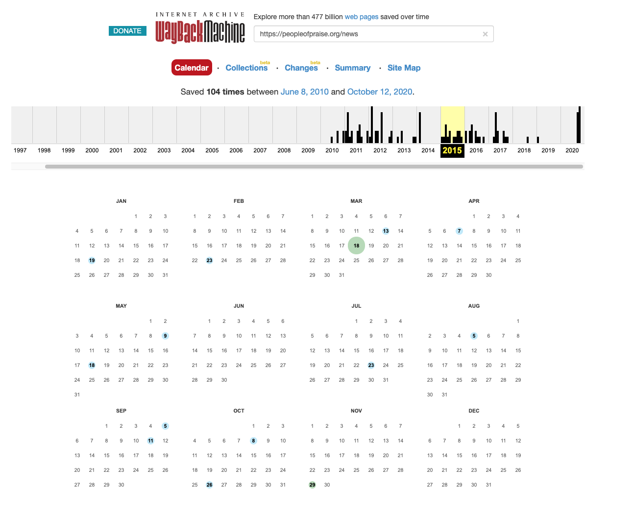

Let’s See if we can Find a Thumbnail
https://web.archive.org/web/20150911091418/https://peopleofpraise.org/news/

Slide 28
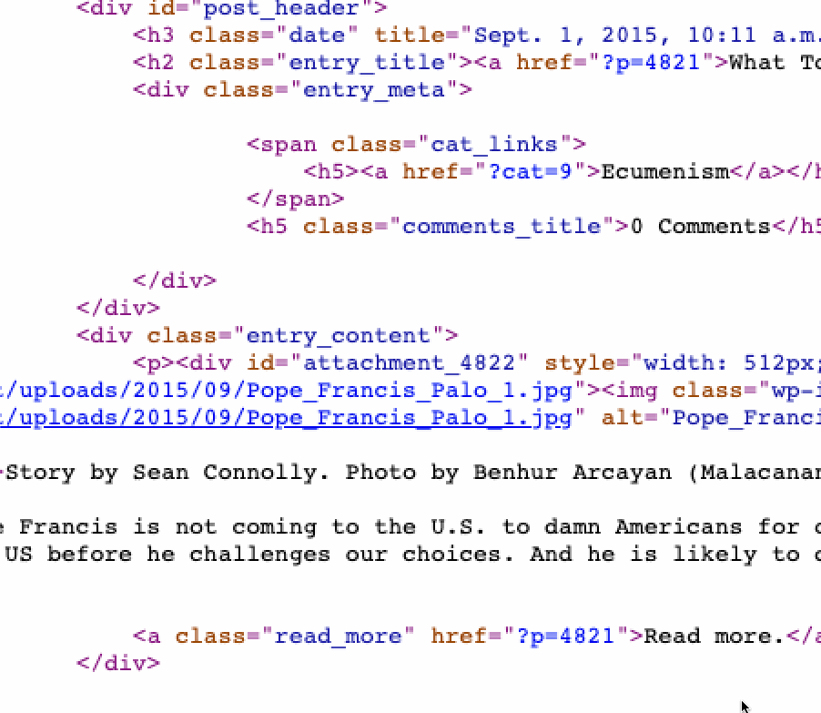
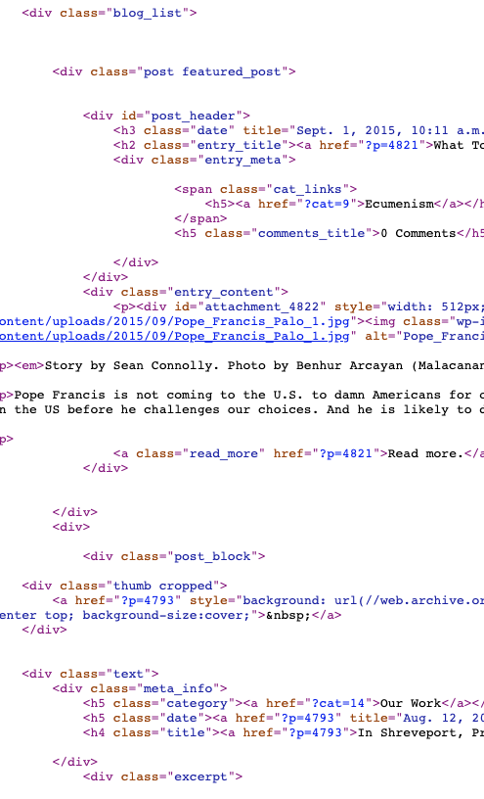
No Joy
https://web.archive.org/web/20150911091418/https://peopleofpraise.org/news/

Slide 29
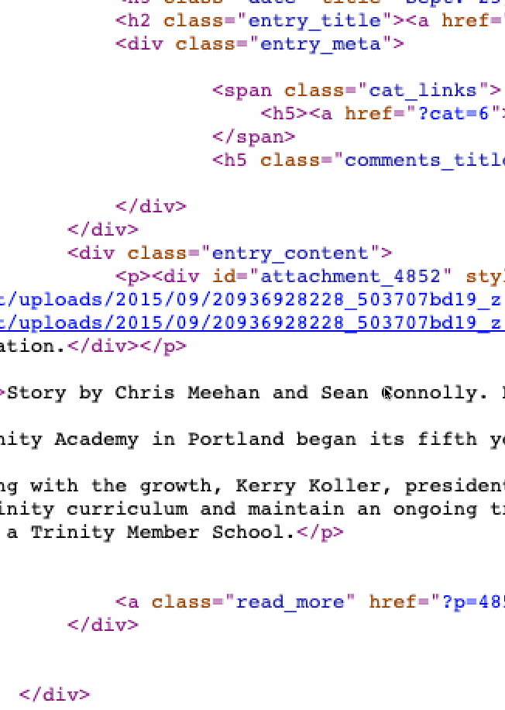

Wasn’t Far Enough
https://web.archive.org/web/20151008043035/https://peopleofpraise.org/news/

Slide 30
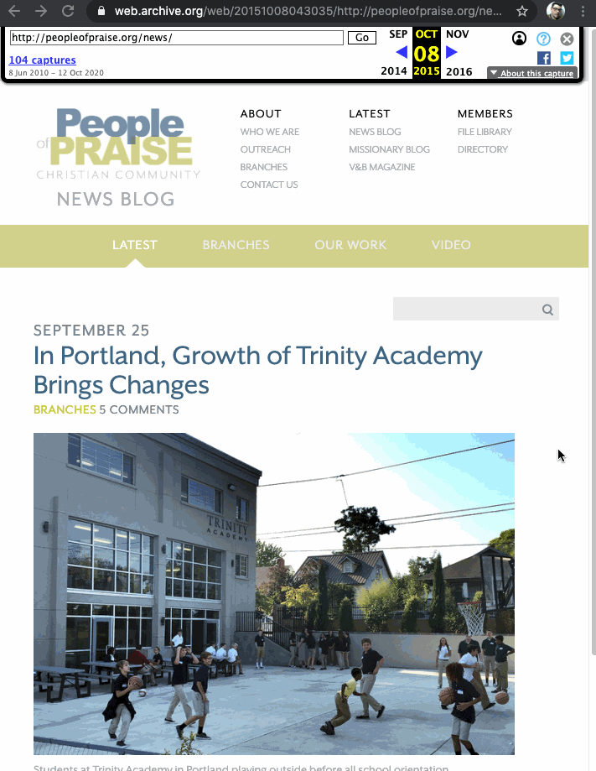

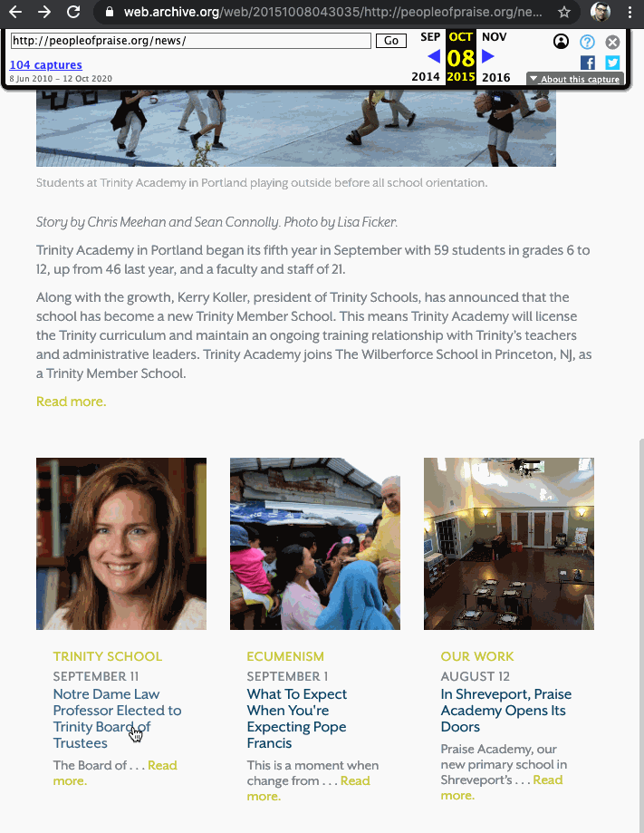
July 3rd, 2018 Someone Archived a Dead Link to a Blog Post About Amy Coney Barrett
https://web.archive.org/web/20151008043035/https://peopleofpraise.org/news/

Slide 31
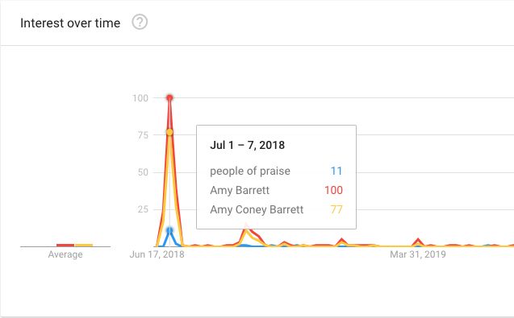
Big Spike Around July 3rd, 2018
https://trends.google.com/trends/explore?date=2018-06-15%202020-08-15&geo=US&q=people%20of%20praise,Amy%20Barrett,Amy%20Coney%20Barrett

Slide 32
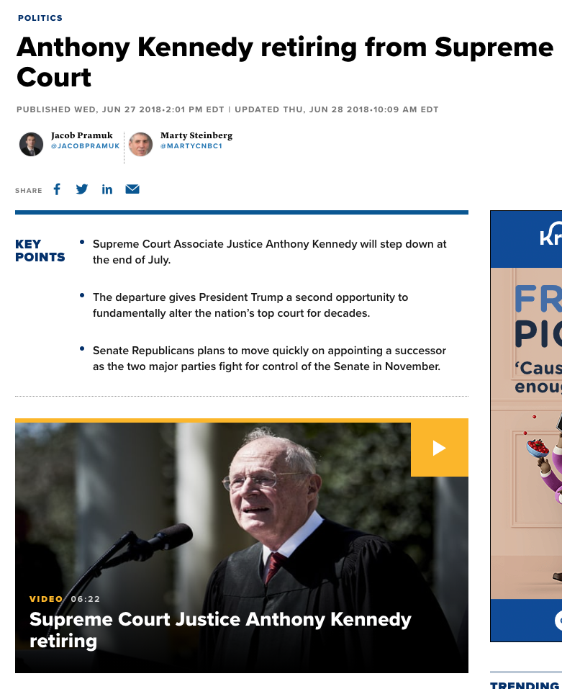
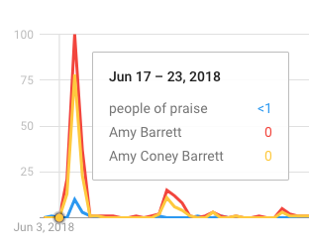
June 27th, 2018 Anthony Kennedy Announces Retirement
https://trends.google.com/trends/explore?date=2018-06-15%202020-08-15&geo=US&q=people%20of%20praise,Amy%20Barrett,Amy%20Coney%20Barrett
https://www.cnbc.com/2018/06/27/anthony-kennedy-retiring-from-supreme-court.html

Slide 33
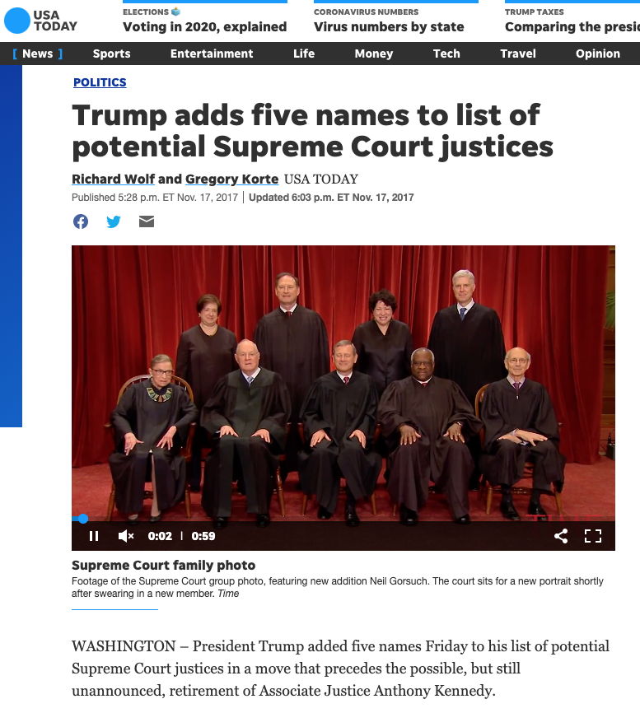
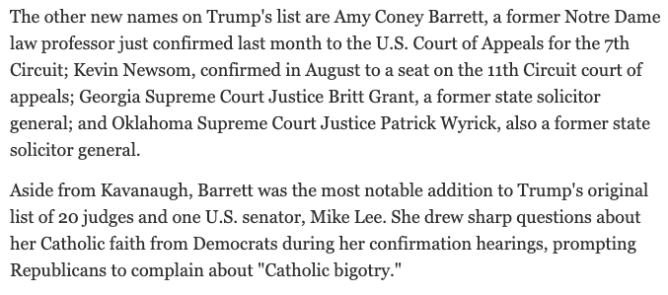
November 17th, 2017 Trump Added Amy Barrett to Short List for Supreme Court
https://www.usatoday.com/story/news/politics/2017/11/17/trump-adds-five-names-list-potential-supreme-court-justices/875983001/

Slide 34
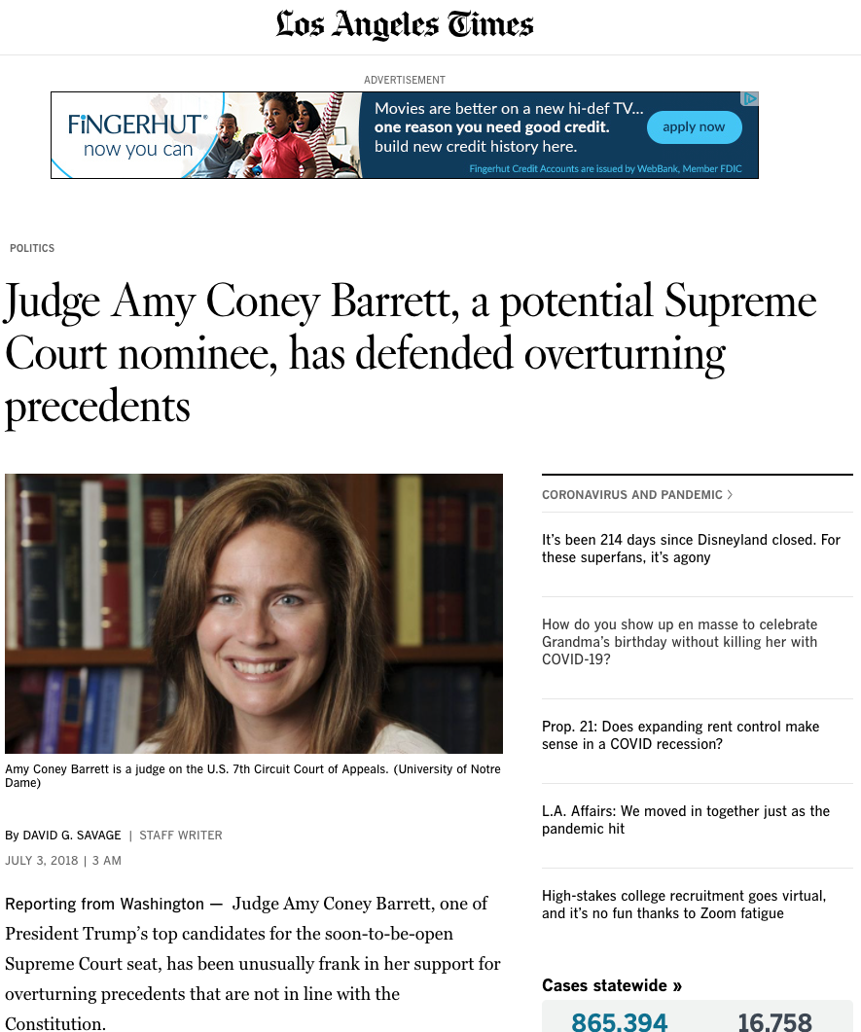
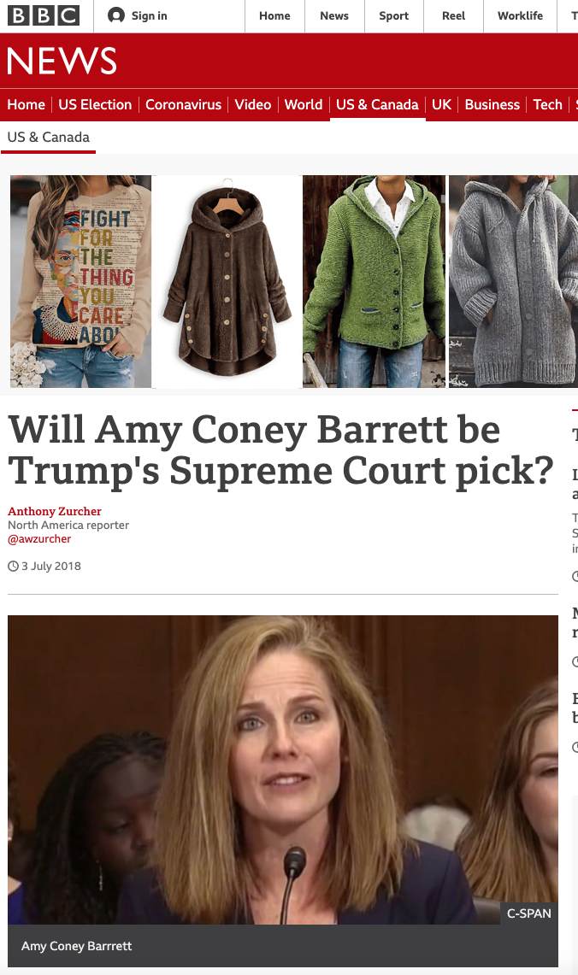

July 3rd, 2018 A Lot of Chatter about Amy Barrett
https://www.latimes.com/politics/la-na-pol-court-abortion-precedent-20180703-story.html
https://www.bbc.com/news/world-us-canada-44686989
https://www.washingtonpost.com/news/the-fix/wp/2018/07/02/one-possible-trump-supreme-court-pick-who-makes-too-much-sense/

Slide 35
Deleted Just as Trends Spike
News blog post 4829 archived as dead link
Serious talk of Amy Barrett being nominated to Supreme Court
https://trends.google.com/trends/explore?date=2018-06-15%202020-08-15&geo=US&q=people%20of%20praise,Amy%20Barrett,Amy%20Coney%20Barrett

Slide 36
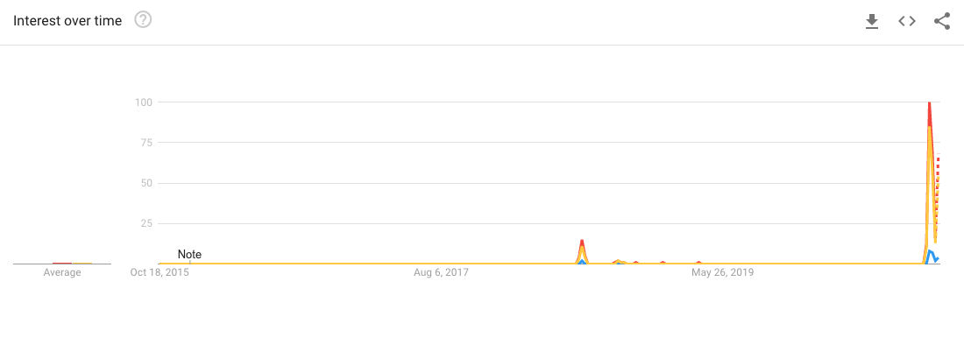
The Big Picture
COMPLETELY REMOVED ACCESS TO ALL ISSUES OF V&B
Amy Barrett Nominated to Supreme Court
News blog post 4829 archived as dead link
Anthony Kennedy Retires
Ruth Bader Ginsburg Passes
First V&B Purge
Neil Gorsuch Nominated
Second V&B Purge
Amy Barrett on Short List for Supreme Court
https://trends.google.com/trends/explore?date=today%205-y&geo=US&q=people%20of%20praise,Amy%20Barrett,Amy%20Coney%20Barrett

Slide 37
Each Data Purge is a Reaction to Judicial News
First Vines and Branches Purge (2017-03-04)
Gorsuch nomination (2017-01-31)
Gorsuch hearings (2017-03-20)
Second Vines and Branches Purge (2017-06-07)
Amy Barrett nominated to 7th Circuit Court of Appeals (2017-05-08)
Amy Barrett’s confirmation hearings (2017-10-16)
News Post 4829 (2018-07-03)
Anthony Kennedy’s retirement announcement (2018-06-27)
Amy Barrett on short list for vacancy (2017-11-17)
Complete Vines and Branches Purge (2020-09-23)
Ruth Bader Ginsburg’s death (2020-09-18)
Amy Barrett’s nomination to vacancy (2020-09-26)

